Slide 1
SaaS Subscription & Churn Analysis
Stakeholder report: what each Power BI page tells us and what to do next
Period analysed: Jan 2023 to Dec 2024 | 5 report pages | 500 customer accounts

Slide 2
Executive summary
$122M
22.0%
$4.66M
2.4 : 1
Annual recurring revenue ($10.16M MRR)
Account churn rate (110 of 500)
MRR flagged at risk (226 accounts)
Upgrades to downgrades (529 vs 218)
1
Growth is strong but new-logo driven. MRR climbed from near zero to about $10.2M in 24 months; new MRR ($11.34M) is 9x expansion ($1.26M).
2
Churn is the main threat. 22% of accounts churned and monthly churn events reached about 95 by Dec 2024. Product features, support and budget lead the stated reasons.
3
Risk is concentrated by industry, not plan. Churn is ~22% on every plan, but DevTools churns at 31% versus about 16% for Cybersecurity and EdTech.
4
Reliability and feedback gaps limit insight. Error rates sit at 5.6% to 6.6% on top features, and 41% of support tickets have no satisfaction response.

Slide 3
Executive Overview: business questions answered
Visual | Business question | What it shows
KPI cards | Is the business healthy and how large is the recurring revenue base? | $10.16M MRR ($122M ARR) across 500 accounts, about $20.3K MRR per account; 22% churn.
MRR trend by month | Is recurring revenue growing, and is growth accelerating? | MRR rises from near $0 (Jan 2023) to about $10.2M (Dec 2024), with the steepest steps in the last six months.
MRR by plan tier | Which plan tier contributes the most revenue? | Basic $3.7M, Pro $3.5M, Enterprise $2.9M (see data checks: the Plan Performance table splits differently).
MRR by industry | Which verticals drive revenue and is there concentration? | FinTech $2.42M (24%), DevTools $2.17M, Cybersecurity $1.97M, EdTech $1.84M, HealthTech $1.76M.
Churn rate by plan tier | Does a particular tier lose customers faster? | Pro 72.5%, Enterprise 70.1%, Basic 68.5%: tiers are close, so tier alone does not explain churn.
Date, plan, country slicers | Does the story hold for a given period, tier or market? | Lets leaders test any KPI by window (1 Jan 2023 to 31 Dec 2024), plan tier and country.
Stakeholders: CEO, CFO, Board and investors, Head of Strategy

Slide 4
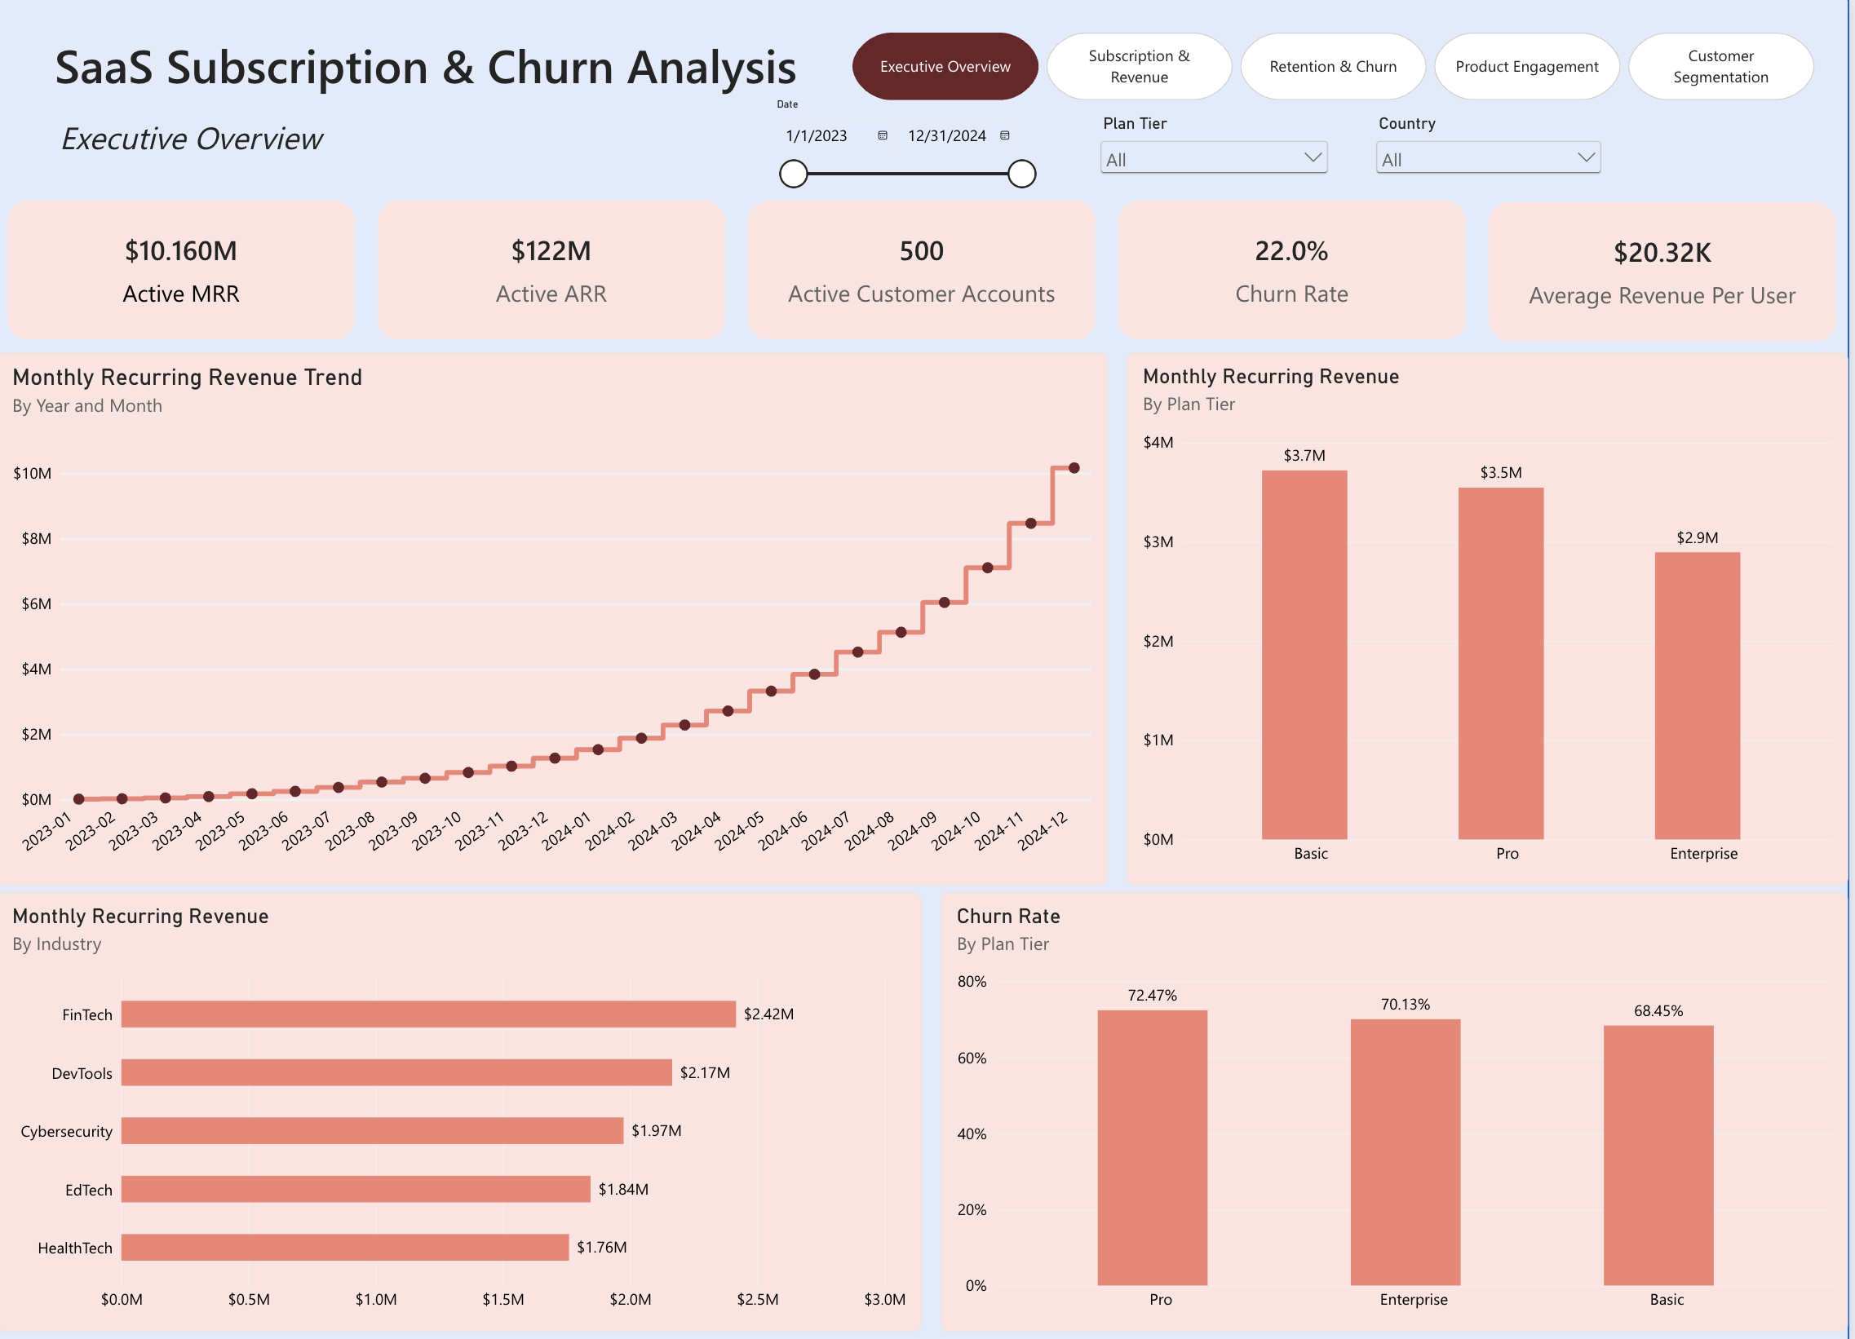
Executive Overview: key findings and actions
Hockey-stick revenue growth
MRR reached about $10.2M, and the final month alone added the largest single step on the trend.
Revenue is diversified by industry
No vertical exceeds 24% of MRR; FinTech and DevTools together are about 45%.
22% churn is material
110 of 500 accounts churned. Note "Active Customer Accounts" shows 500, equal to total accounts, so label and definition need a check.
Recommended action: Report MRR, ARR and churn together in every board pack, agree one churn definition, and set a target churn rate for 2025.

Slide 5
Subscription & Revenue: business questions answered
Visual | Business question | What it shows
KPI cards | How much revenue is gained and lost in the period? | Active MRR $10.16M, new $11.34M, expansion $1.26M, churned $1.18M.
MRR & monthly revenue movement | Is net MRR movement growing month to month? | Net monthly movement grows from near zero to about $2M by Dec 2024; Active MRR steps up with it.
Current MRR by plan tier | How is MRR split across tiers? | Basic $3.7M, Pro $3.5M, Enterprise $2.9M as charted.
MRR movement drivers | What drives MRR change: new, expansion, contraction or churn? | New +$11.3M, expansion +$1.3M, contraction -$0.5M, churn -$1.2M.
Upgrades vs downgrades | Are customers trading up or down? | 529 upgrades versus 218 downgrades, about 2.4 upgrades per downgrade.
Plan performance table | Which plan has the best accounts, ARPU, churn and plan movement? | Enterprise: $7.55M MRR, $15.1K ARPU, 194 upgrades. Pro has the most downgrades (90). Plan churn is 70.9% to 71.6%.
Stakeholders: CFO, Finance and RevOps, Pricing and Product Marketing, Head of Sales

Slide 6
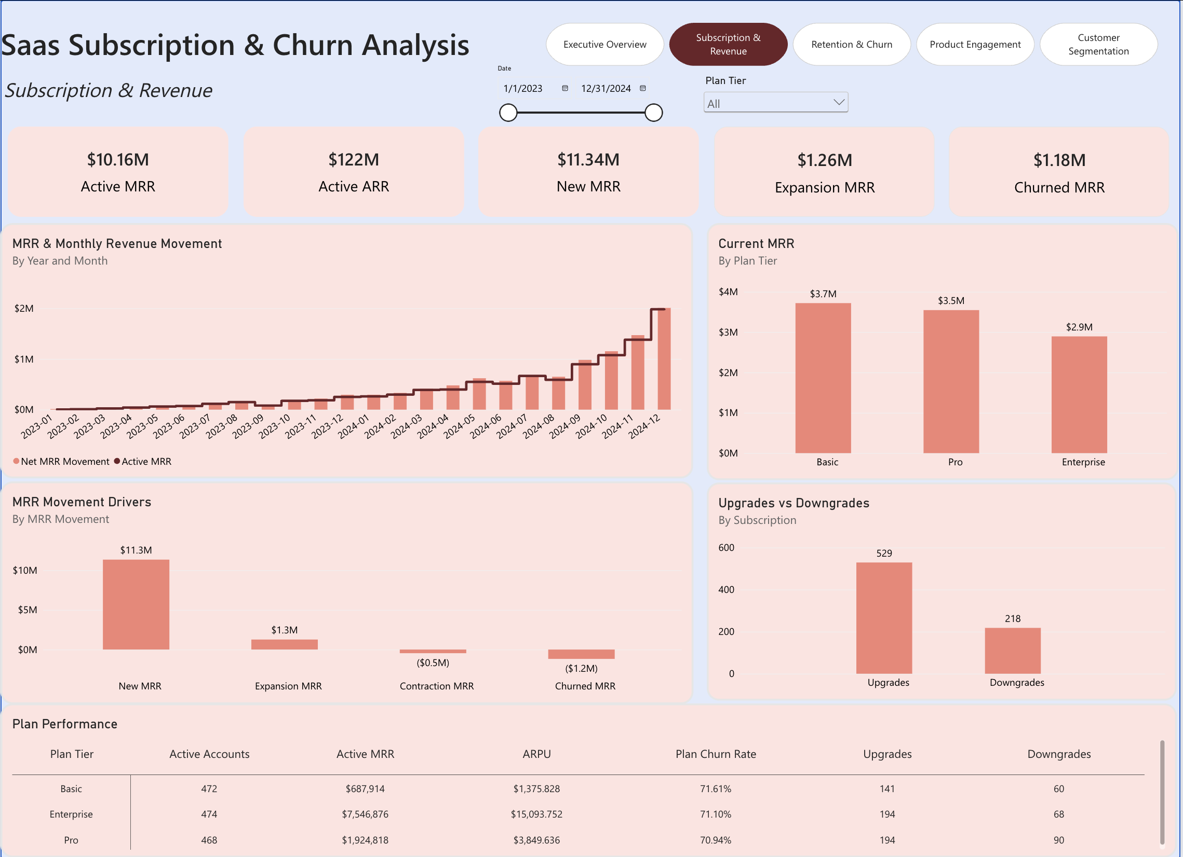
Subscription & Revenue: key findings and actions
Growth is new-logo driven
New MRR is 9x expansion MRR, and expansion ($1.26M) barely covers churned MRR ($1.18M), so the installed base is not growing itself.
Upgrades outpace downgrades, but Pro leaks
Enterprise has the best ratio (194 up, 68 down); Pro is weakest with 90 downgrades against 194 upgrades.
Enterprise carries the revenue
The plan table puts Enterprise at $7.55M, about 74% of Active MRR, so its health drives the forecast.
Recommended action: Build net and gross revenue retention metrics, launch an expansion playbook for existing accounts, and review Pro packaging to reduce downgrades.

Slide 7
Retention & Churn: business questions answered
Visual | Business question | What it shows
KPI cards | How big is churn in accounts and dollars, and can we win customers back? | 110 churned accounts, $1.18M churned MRR ($1.97K average), reactivation only 10.17%.
Monthly customer churn | When does churn happen and is it worsening? | Under 10 events a month for most of 2023, rising to about 95 in Dec 2024 after a sharp final-month jump.
Why customers churn | What reasons do customers give? | Features 114, budget 104, support 104, unknown 95, competitor 92, pricing 91.
Lost MRR by churn reason | Which reasons cost the most revenue? | Features $2.1M, support $1.9M, budget $1.8M, unknown $1.7M, pricing and competitor $1.6M each.
Churned customers by industry | Which industries lose the most customers? | DevTools 83, FinTech 76, Cybersecurity 72, HealthTech 64, EdTech 57.
Churn rate by plan tier | Does plan tier drive churn? | Enterprise 22.1%, Basic 22.0%, Pro 21.9%: effectively flat.
Churned customers by country | Where are lost customers located? | Largest bubbles in North America, then Western Europe and India.
Stakeholders: VP Customer Success, Retention team, Product Management, Sales leadership

Slide 8
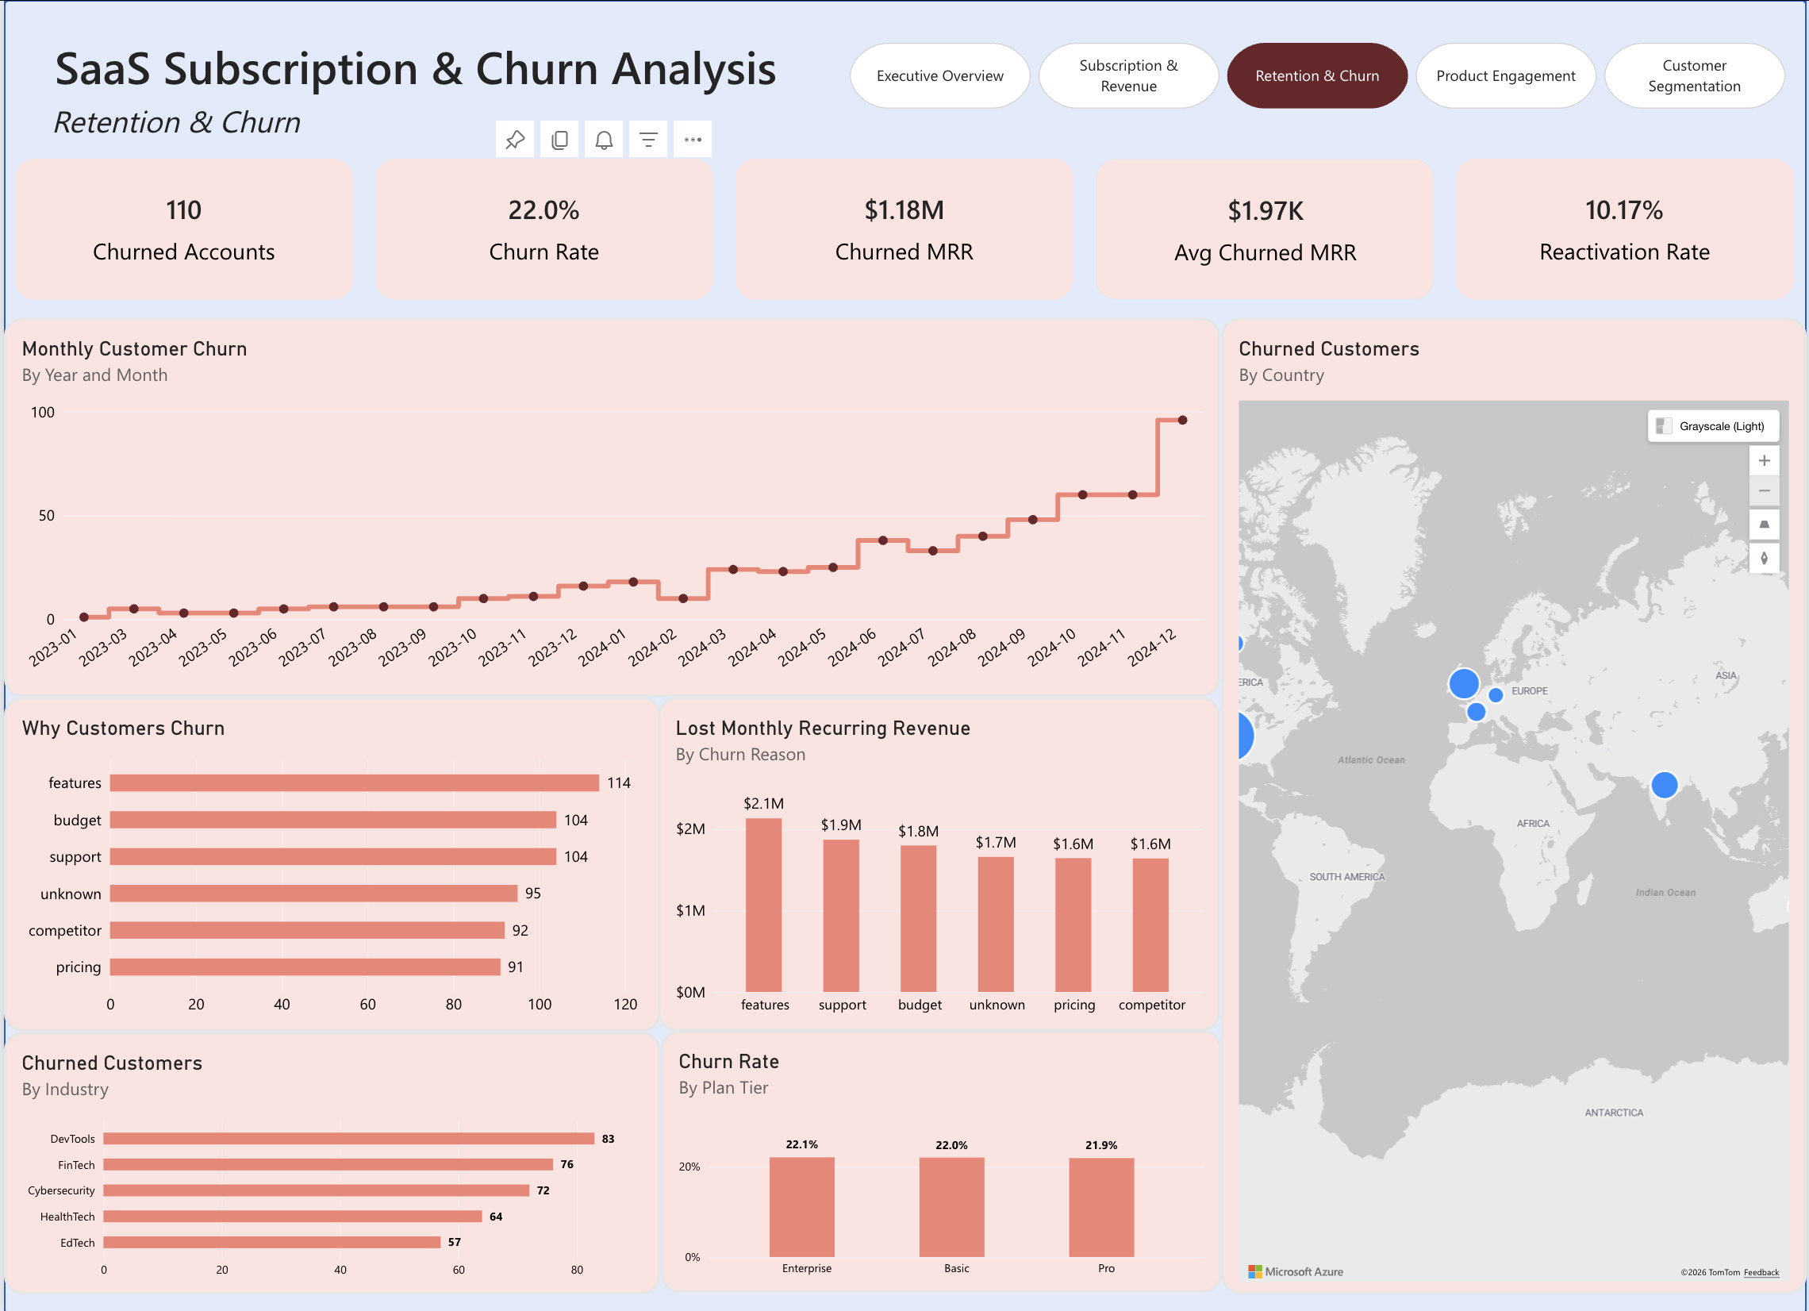
Retention & Churn: key findings and actions
Churn rises with the customer base
Monthly events grew from single digits to about 95; a cohort view is needed to separate scale from real deterioration.
No single dominant cause
The top reason is only 19% of 600 events. Features and support, the controllable ones, account for 36%; "unknown" is 16%.
Industry, not plan, is the lever
Plan churn is flat at about 22%, while industry rates range from 16% to 31% (see Segmentation page).
Recommended action: Make exit reasons mandatory, launch a DevTools retention program, and build a win-back flow aimed at lifting the 10% reactivation rate.

Slide 9
Product Engagement: business questions answered
Visual | Business question | What it shows
KPI cards | How much is the product used, how reliable, and how well supported? | 25,000 usage events, 251K total usage count, 5.63% error rate, 2,000 tickets, 4.0 satisfaction.
Feature usage count (top 10) | Which features do customers rely on most? | feature_32 leads at 6.7K; the next nine sit at 6.5K to 6.6K, so usage is evenly spread.
Feature error rate (top 10) | Which features fail most often? | feature_4 6.56%, feature_9 6.51%, feature_26 6.45%, all above the 5.63% average.
Support tickets by satisfaction | How do customers rate support interactions? | 825 no response (41%), 779 high, 396 neutral.
Beta feature usage | How much usage happens on beta features? | 10.18% of 25K usage events are on beta features.
Support ticket severity | How many tickets are severe? | 4.75% flagged true, roughly 95 of 2,000 tickets.
Stakeholders: Chief Product Officer, Product Managers, Engineering and QA, Head of Support

Slide 10
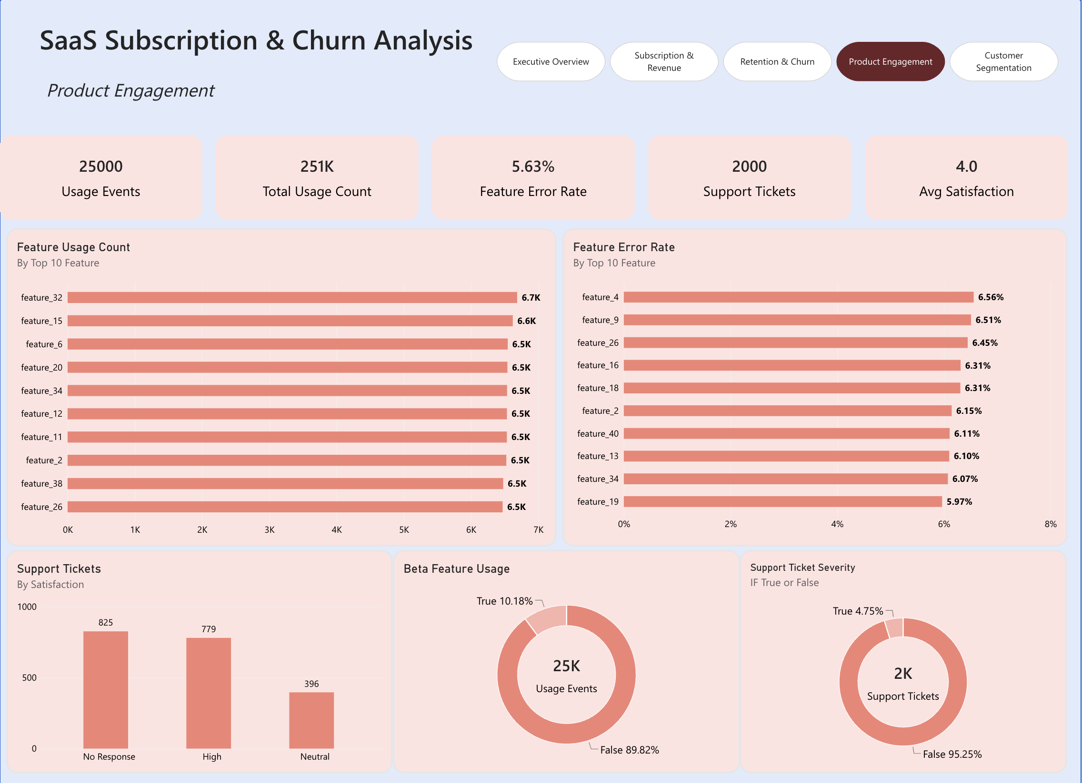
Product Engagement: key findings and actions
Reliability hot-spots
feature_26 and feature_34 appear in both the top-10 usage and top-10 error lists: high traffic and error-prone, so fix first.
Satisfaction is under-measured
With 41% of tickets unanswered, the 4.0 average reflects only responders and may overstate sentiment.
Beta and quality link to churn
Features are the #1 churn reason (114), and about 1 in 10 usage events is on beta; track stability by cohort.
Recommended action: Set error targets for feature_4, 9 and 26, raise survey response rates, and join feature errors to churned accounts.

Slide 11
Customer Segmentation: business questions answered
Visual | Business question | What it shows
KPI cards | How much revenue is exposed and how satisfied are customers? | Customer MRR $11.34M, at-risk MRR $4.66M (41%), ARPU $20.32K, satisfaction 4.0.
Customer value segmentation | How is the base split by value tier? | High 81.8%, Mid 10.8%, Low 7.4% of 500 accounts.
Highest value customers | Who are the key accounts to protect? | Top 10 range from $71K to $138K MRR, about $0.97M combined (roughly 8.5% of Customer MRR).
Customer risk by plan | Which tiers hold the most at-risk accounts? | At risk vs normal: Pro 83/95, Basic 70/98, Enterprise 73/81; 226 of 500 at risk.
Customer health by industry | Which industries are healthiest? | Churn: DevTools 31.0%, FinTech 22.3%, HealthTech 21.9%, EdTech 16.5%, Cybersecurity 16.0%; satisfaction 4.0 everywhere.
Engagement vs MRR scatter | Does usage predict revenue and risk? | Positive but loose link; low-value accounts cluster at low usage, and some $80K+ accounts show only moderate usage.
Stakeholders: Customer Success Managers, Account Management and Sales, RevOps and Marketing

Slide 12
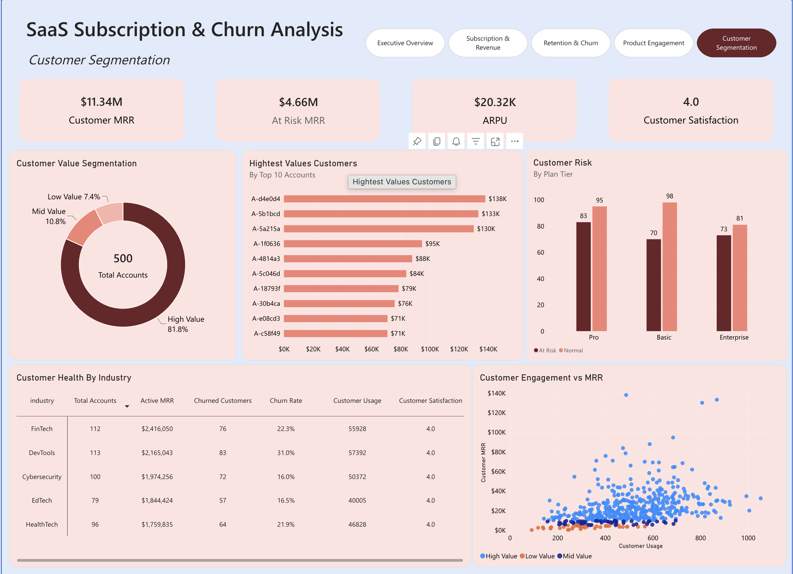
Customer Segmentation: key findings and actions
Exposure is large
226 accounts (45%) and $4.66M MRR are at risk. Enterprise has the highest at-risk share (47%), Basic the lowest (42%).
DevTools is the pressure point
31% churn, nearly double Cybersecurity and EdTech, despite the highest usage per account (about 508) and the same 4.0 satisfaction.
Segments are too loose to prioritise
With 82% labelled High Value, tiers do not focus effort. Revenue concentration is low, as the top 10 hold only about 8.5%.
Recommended action: Assign save plans to the 226 at-risk accounts ranked by MRR, deep-dive DevTools, and recalibrate value thresholds.

Slide 13
Business scenarios and who owns them
Scenario | Business question | Evidence across pages | Owner
Sustain growth | Can new-logo growth keep funding the business? | New MRR $11.34M vs expansion $1.26M; MRR about $10.2M | CEO, CFO
Reduce churn | Where should retention spend go first? | 22% churn; DevTools 31%; features and support 36% of events | VP Customer Success
Pricing and packaging | Are the plan tiers set up correctly? | Pro has most downgrades; churn flat by tier; Enterprise about 74% of MRR | Pricing, Product Marketing
Product quality | Do errors and missing features drive churn? | 5.63% error rate; features top churn reason; feature_26 and 34 hot-spots | CPO, Engineering
Account risk and expansion | Which accounts do we protect or grow? | $4.66M at-risk MRR; 226 accounts; top 10 only 8.5% of MRR | Sales, Account Management

Slide 14
Next steps
Next steps
Align metric definitions and fix measures
Add NRR, GRR and cohort retention
Share each page with its owner and agree one action per page
Review progress monthly against churn and at-risk MRR targets

